Slide 1


Green Building Plumbing and Mechanical Technologies
Mike Cudahy, Presenter
© PPFA 2011
Notes:
Welcome to the PPEF’s online class on green building plumbing and mechanical technologies. In this class, we will review systems that those interested in green building should know, why those systems work, and what the benefits are. Let’s get started by introducing ourselves.

Slide 2


Green Plumbing & Mechanical Technologies
The Plastic Pipe and Fittings Association (PPFA) is a national trade association comprised of member companies that manufacture plastic piping, fittings and solvent cements for plumbing and related applications, or supply raw materials, ingredients or machinery for the manufacturing process. One of the primary goals of the association is to educate architects, engineers, installers and end-users to the benefits of plastic piping systems.
© PPFA 2011
Introduction
Notes:
This class was developed by PPEF, the Plastic Piping Education Foundation, which is the educational foundation of PPFA - PPFA is comprised of manufacturers and consultants in the plastic piping industry. One of the primary goals of the association is to educate architects, engineers, installers and end-users to the benefits of plastic piping systems

Slide 3
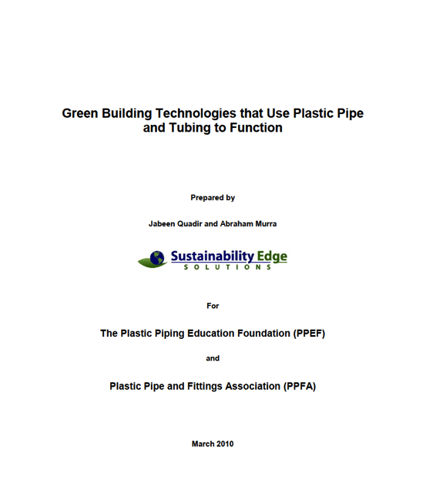
Green Plumbing & Mechanical Technologies
Most of the source material used in this presentation was obtained from, “Green Building Technologies that Use Plastic Pipe and Tubing to Function”.
Technology Overview
Savings (conservation)
Life Safety Impacts
Indoor Environmental Quality Impacts (IEQ)
Materials Used
Operating Examples
Information Source Materials
Notes:
The PPEF had a report developed in 2010 to see where piping products had applications in green and sustainable building – it was carried out by Sustainability Edge Solutions.
Most of the source material used in this presentation was obtained from the report, “Green Building Technologies that Use Plastic Pipe and Tubing to Function”.
The report contains multiple technologies and each section contains;
Technology Overview
Savings (conservation)
Life Safety Impacts
Indoor Environmental Quality Impacts (IEQ)
Materials Used
Operating Examples
Information Source Materials

Slide 4
Green Plumbing & Mechanical Technologies
Gray Water Reuse Systems
Rainwater Harvesting
Geothermal Energy Systems
High-Efficiency Hot Water Distribution Systems
Radiant Heating Systems
Solar Water Heating Systems
Water Efficient Irrigation Systems
Onsite Wastewater Treatment Systems
Radon Venting
Central Vacuum Systems
Residential Fire Sprinkler Systems
© PPFA 2011
Introduction
Notes:
We quickly found out how our products were to systems that reduced the environmental impacts of the building – esp. during the use phase.
In short, green and sustainable buildings use a lot more piping, and for many good reasons.
Most of the systems had the quickest economic payback in commercial applications.

Slide 5
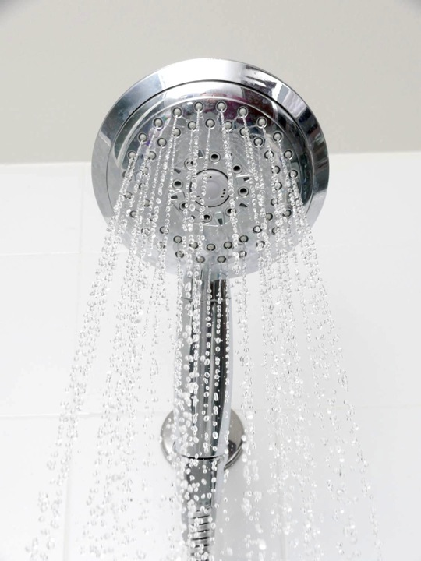
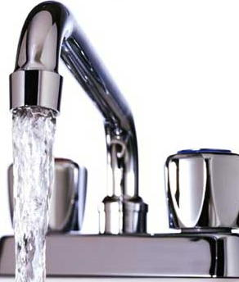
Green Plumbing & Mechanical Technologies
Notes:
First, some background
Here is - definitely - one of the most taken for granted resources we all have.
Devices that to the consumer, seem to be endless sources of both hot water and safe potable water.
One question is, are we designing and installing these - and other plumbing and mechanical systems as well as they should be?
Are there other P&M systems we should be installing?

Slide 6
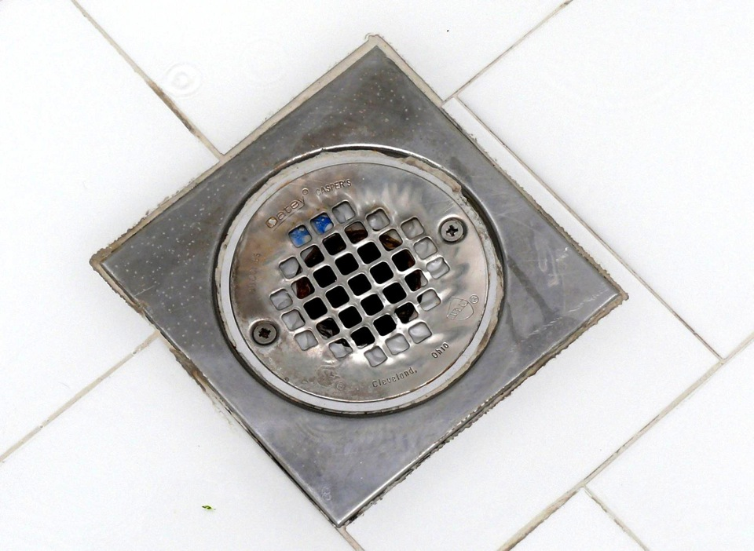
Green Plumbing & Mechanical Technologies
Notes:
This is where a lot of a homes potable water and the energy we put into hot water ends up – wasted.
It’s “a drain on our resources”, but there is much we can do, as designers and builders to improve upon business as usual.
Many green systems do require additional input during design and construction but reduce consumption during the critical use phase of the building. During the initial construction phase, these systems can often be added more easily at a relatively lower cost then a retrofit later on, giving the original builder an advantage.

Slide 7
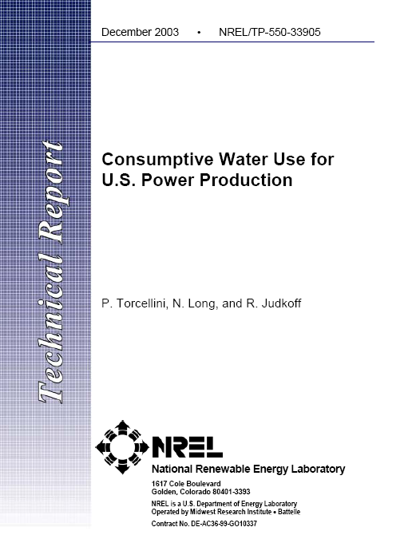
Green Plumbing & Mechanical Technologies
The national weighted average ….is 2.0 gal (7.6 L) of evaporated water per kWh of electricity.
Notes:
One more important point before we discuss the systems and applications. You should know that energy and water conservation are connected, in fact, any use of grid electricity consumes water and consumption of potable water consumes energy.
In a NREL report, “consumptive water use for US power production”, the average was determined to be about 2 gallons of water evaporated per kWhr consumed by the user.
On the other side, some 7-8% of the US power is used to transport and treat water.
In short, if you save water, you save electricity, and if you save electricity, you save water.

Slide 8
Green Plumbing & Mechanical Technologies
Green Plumbing & Mechanical Technologies
Green and Sustainable building technologies enabled by piping systems, may be divided into 3 major areas:
Water Conserving (blue)
Energy Conserving (red)
IEQ Quality / Life Safety (cloud)
© PPFA 2011
Introduction
Notes:
The 11 Green and Sustainable building technologies enabled by piping systems studied in the report, may be divided into 3 major areas:
During this presentation, you will be able to tell the chief advantage by the border color on the slides describing the systems.
Water Conserving (blue border)
Energy Conserving (red border)
IEQ Quality / Life Safety (cloud border)
General information slide will be green.
We will be presenting these systems according to maximum benefit.

Slide 9
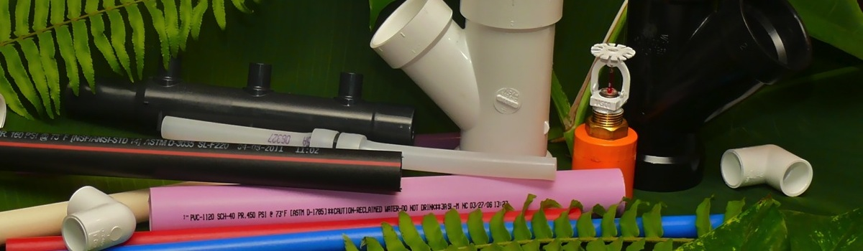
Piping Systems Used:
Green Plumbing & Mechanical Technologies
Plastic piping systems dominated most systems studied because of a few important factors;
Durable, corrosion resistance
Light weight, lower cost
Ease of marking / available colors
© PPFA 2011
Introduction
Notes:
Plastic piping systems dominated most systems studied because of a few primary advantages.
Durable, corrosion resistance allows the installed system to have a long service life, even with unusual or corrosive water
Light weight, and lower cost means systems become more affordable
Ease of marking / available colors means that potentially hazardous cross connections of systems are avoided.

Slide 10
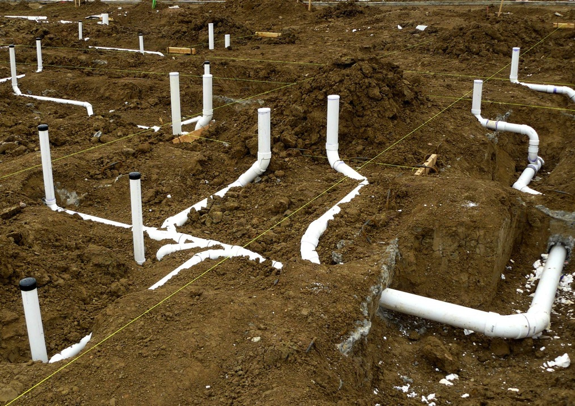
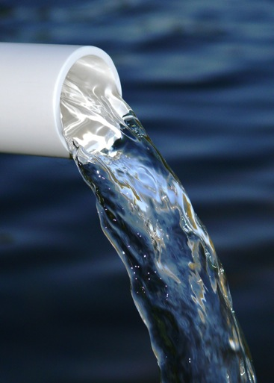
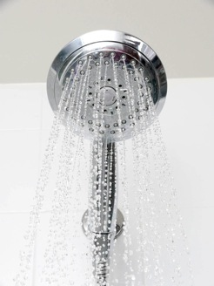
Water Conservation Systems
© PPFA 2011
Notes:
It should come as no surprise that piping systems would be involved in water conservation. More efficient use of water, along with use of alternative sources of water make up the majority of these systems, which include, Gray Water Reuse, Rainwater Harvesting, Water Efficient Irrigation Systems, and Onsite Wastewater Treatment Systems.

Slide 11

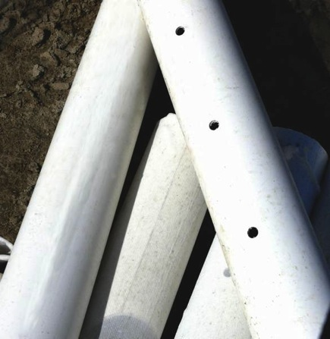
Gray Water Reuse Systems
The EPA WaterSense program report indicates that the average US family of four uses about 400 gallons a day.
7 to 8% of the energy used in the US is used for the treatment and transportation of potable water.
© PPFA 2011
Water Conservation Systems
Notes:
Onto our first green P&M system – gray water reuse systems
The EPA WaterSense program report indicates that the average US family of four uses about 400 gallons a day of potable water. This is over 3,000 pounds of water which must be treated and often pumped long distances, both to and from a home.
Most of this potable water is used and sent right down the drain in a relatively good quality, then transported and treated again, as sewage. In fact, the report estimated that 7 to 8% of the energy used in the US is used for the treatment and transportation of potable water.
Is there a way to divert some of this stream for reuse? Yes, and it is called gray water reuse. Sometimes called “showers for flowers” for reasons we will see later.

Slide 12
Gray Water Reuse Systems
Reuse of selected potable water waste:
Showers,
Clothes Washers,
Lavatory (bathroom) Sinks,
Laundry Sinks.
Every house already has “gray water and black water” - we just don’t pipe and reuse it.
© PPFA 2011
Water Conservation Systems
Notes:
One of the advantages of a gray water reuse system is that every building typically has a ready, and consistent source – we just are not taking advantage of it, and unlike rainwater, gray water is generated basically every day.

Slide 13
Gray Water Reuse Systems
© PPFA 2011
Water Conservation Systems
Notes:
For example, I did a water balance on my own home and came up with the following data for irrigation, gray water and black water.
The use of the gray water for irrigation would reduce the use of potable water by a large margin.

Slide 14
Gray Water Reuse Systems
Gray water reuse can be very simple, or complex designed and engineered systems.
  Clothes Washer and/or Shower to Irrigation
  Lavatory Sink to Water Closet Flush
  Gray water to a Cistern and Subsurface Irrigation
  Gray water to Full Treatment and Multiple Uses
© PPFA 2011
Water Conservation Systems
Notes:
A gray water system can be very simple, or very complex. Sometimes a shower or a clothes washer is simply piped to a garden for indirect irrigation – the “showers to flowers” type.
More complex systems will collect from multiple sources, filter, treat and reuse the gray water for other uses, such as flushing water closets.

Slide 15
Gray Water Reuse Systems
Use of gray water can conserve 30-40% of water, about 39 GPD/person, and reduce the quantity discharged to the sewer.
Reduce potable water consumption
Potentially reduce sewer fees
© PPFA 2011
Water Conservation Systems
Notes:
Savings can be good – and can reduce the consumption of potable water, reduce the quantity discharged to the sewer and may reduce sewer fees.

Slide 16
Gray Water Reuse Systems
© PPFA 2011
Notes:
The time to design and install a gray water system is before this picture was even taken. Well before the home is even built. A complex system is really difficult to do afterwards in a finished slab on grade home.
There are other significant design details in gray water systems for residential construction – and not all vegetation is well suited for irrigation by the systems.
The other good thing about gray water systems is that the systems are used every day - without effort or thought.
Even if you do not plan on a complete system, pre-installing at least the collection system makes sense, esp. in a slab home.

Slide 17
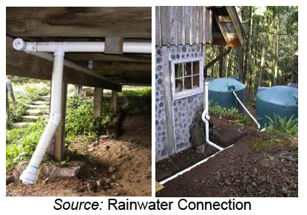
Rainwater Harvesting
© PPFA 2011
Water Conservation Systems
Notes:
Rainwater harvesting is something we have done for thousands of years and seem to be rediscovering – in some island nations, rainwater harvesting is used for everything, including drinking water – as it is all they have.

Slide 18
Rainwater Harvesting
Systems Consist of:
Catchment Area – Roof with suitable materials
First Flush Device
Conveyance
Cisterns – most investment and critical
Delivery System
Treatment System (Filter/UV, etc)
© PPFA 2011
Water Conservation Systems
Notes:
Rain water harvesting systems consist of:
A catchment area – such as a roof with suitable (safe) materials
Potentially a First Flush Device to divert the first few gallons of roof tramp material contaminated rainfall from the collection tank
Conveyance - piping
Cisterns – most investment and critical for sizing the system.
A delivery system – could be gravity or pumped, and
Potentially a treatment System (Filter/UV, etc)

Slide 19
Rainwater Harvesting
Other benefits:
Reduced Storm Water Runoff
Higher purity then gray water or well water
Outdoor uses – irrigation, car washing
Indoor uses – clothes washing with soft water, flushing, some systems can produce potable water.
© PPFA 2011
Water Conservation Systems
Notes:
Other benefits of rainwater harvesting include
Reduced Storm Water Runoff from the building site
Rainwater is typically of a higher purity then gray water or well water
Perfect for outdoor uses – such as irrigation, or car washing
and even suitable for some Indoor uses – clothes washing with soft water, flushing, some systems can produce potable water.

Slide 20
Rainwater Harvesting
Issues:
Collected rainwater can be aggressive and corrosive to metallic piping such as copper.
A first flush device can improve the quality of the water by excluding the first few gallons of rainfall.
© PPFA 2011
Water Conservation Systems
Notes:
There are some issues with rainwater - :
Collected rainwater can be aggressive and corrosive to metallic piping such as copper and we recommend plastic piping.
A first flush device can improve the quality of the water by excluding the first few gallons of rainfall.

Slide 21
Rainwater Harvesting
A $20,000 Commercial system was determined to have about a one year payback.
A $5,000 system will have a negative payback on a residential building (cistern).
One example system in the report cost around $1,500 and provides 27,000 gallons a year.
© PPFA 2011
Water Conservation Systems
Notes:
In the report, a $20,000 Commercial system was determined to have about a one year payback.
A $5,000 system will have a negative payback on a residential building (cistern).
One example system in the report cost around $1,500 and provides 27,000 gallons a year.

Slide 22
Rainwater Harvesting
Important! Consider local or state code requirements before installing:
Colorado restricts harvesting “water rights” state
Also consider rainfall event frequency, roof area, and water demand to size cisterns. A 1,000 sq/ft collection surface can collect 600 gallons per inch of rainfall.
© PPFA 2011
Water Conservation Systems
Notes:
Important! Consider local or state code requirements before installing:
Colorado restricts harvesting – it is a “water rights” state, and you may not own the water.
Also consider rainfall event frequency, roof area, and water demand to size cisterns. A 1,000 sq/ft collection surface can collect 600 gallons per inch of rainfall.

Slide 23
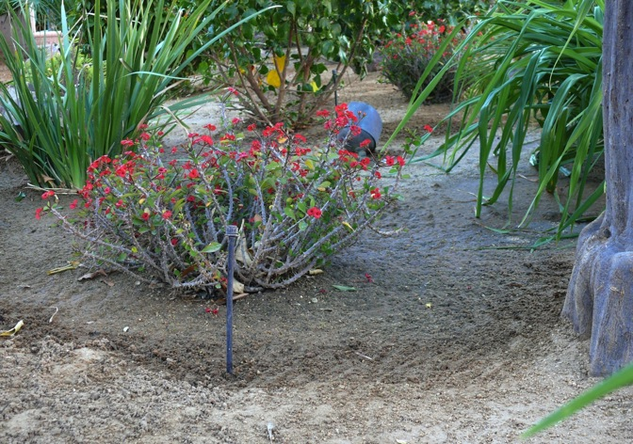
Water Efficient Irrigation Systems
The report estimated that 30% of residential potable water goes to irrigation. Making just a 30% improvement would be 7,000 gallons a year per home!
© PPFA 2011
Water Conservation Systems
Notes:
Outdoor irrigation is a large use of treated potable water. The report estimated that 30% of residential potable water goes to irrigation. Making just a 30% improvement would be 7,000 gallons a year per home!

Slide 24
Water Efficient Irrigation Systems
Most of this depends on only supplying what is need to the landscape:
Professionally designed – landscape
Zoning plants for their water need
Moisture / rain detectors
Drip irrigation
Special emitters
Re-locatable emitters
PE and PVC are the most common materials for irrigation
“Xeriscaping” is another term for this practice
© PPFA 2011
Water Conservation Systems
Notes:
A water efficient system will reduce the quantity of water used. Consider the following:
Professionally designed – landscape
Zoning plants for their water need
Use of Moisture / rain detectors
Installing Drip irrigation or Special emitters and use of flexible piping can make some of the emitters re-locatable if the landscape is changed in the future.

Slide 25
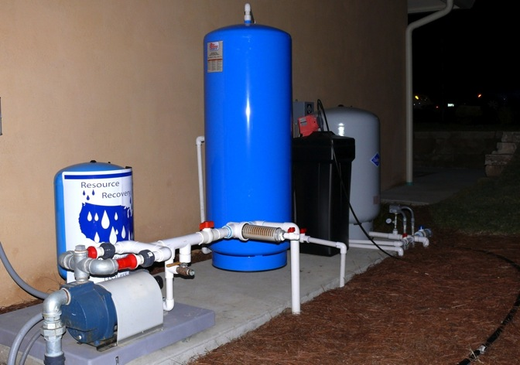
Decentralized (Onsite) Wastewater Treatment Systems
© PPFA 2011
Water Conservation Systems
Notes:
Decentralized wastewater treatment systems treat individual or small groups of homes not connected to a municipal sewerage system returning all of the wastewater (black and gray) for uses such as irrigation.

Slide 26

Decentralized (Onsite) Wastewater Treatment Systems
© PPFA 2011
Water Conservation Systems
Notes:
Remember, the weight of water that needs to be transported to and from a home is significant. It can be about the weight of an automobile. Every day.
By treating all of the waste water onsite, you eliminate the sewer side impacts and conserve water if it is used onsite for irrigation.

Slide 27
Decentralized (Onsite) Wastewater Treatment Systems
Advantages:
Can be cost effective compared with extending municipal sewerage lines.
May lower / eliminate sewer fees.
Reduce the load on local treatment facilities
© PPFA 2011
Water Conservation Systems
Notes:
Remember, the weight of water that needs to be transported to and from a home is significant. It can be about the weight of an automobile. Every day.
By treating all of the waste water onsite, you eliminate the sewer side impacts and conserve water if it is used onsite for irrigation.

Slide 28
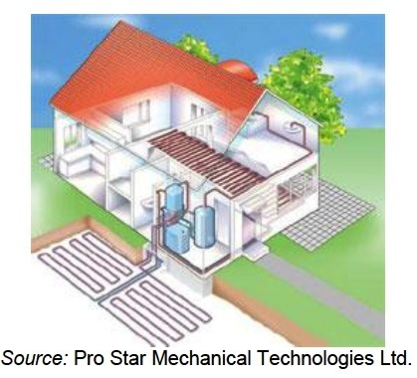
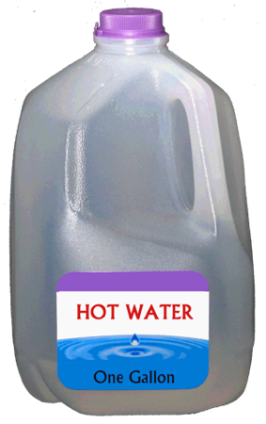
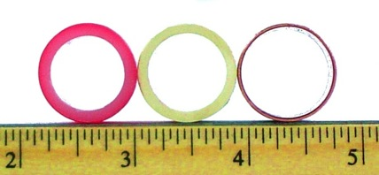
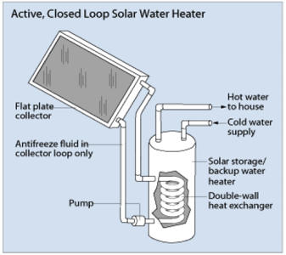
Energy Conservation Systems
© PPFA 2011
Notes:
While water conservation is obvious, you may not be aware that piping based and enabled systems can also be energy (and energy and water) conservation systems too.
Geothermal ground loops, better designed hot water delivery systems, solar water heaters and radiant heating are examples.

Slide 29
Geothermal Energy Systems
Heat in winter
Cooling in summer
Even produce hot water
Normal A/C or radiant operation
© PPFA 2011
Energy Conservation Systems
Notes:
The first system, and one with tremendous energy savings potential is geothermal ground loop /heat pump systems.
These systems can produce heat in the winter, cooling in summer and even produce hot water as a byproduct. Typically used for space heating, they can be a part of a normal air A/C system, or a radiant system, as seen in the picture.

Slide 30
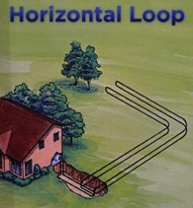
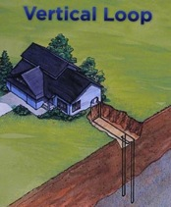
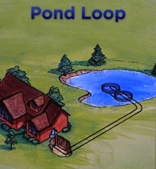
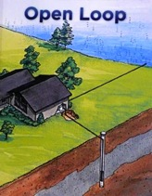
Geothermal Energy Systems
Many configurations for the loops
depending on local conditions
Saves the most energy of the systems studied
35% space heating
© PPFA 2011
Energy Conservation Systems
Notes:
The secret to the efficacy of geothermal ground loop systems is the consistent and renewable temperature of the Earth several feet down. While higher air temperatures in summer make the normal A/C system work harder, several feet down, it may maybe 50-60F, and similarly in winter, when all above ground is frozen, several feet down is it still 50-60F. Depending on the terrain, several “loops” are possible as seen in the image.

Slide 31
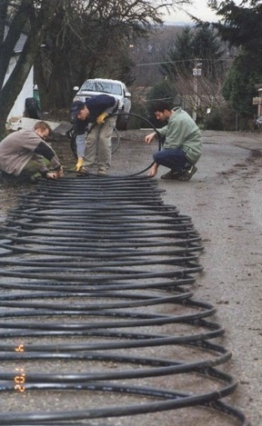
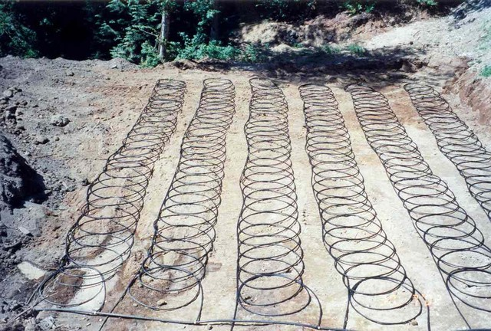
Geothermal Energy Systems
Loops are typically made of polyethylene piping – systems are water based.
© PPFA 2011
Energy Conservation Systems
Notes:
Loop piping is typically a foot per foot under A/C and polyethylene is the predominate piping for water based systems.

Slide 32
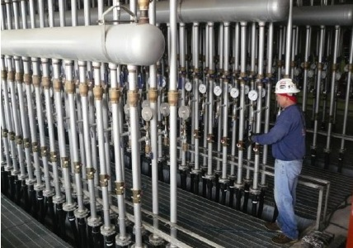
Geothermal – Example System
© PPFA 2011
Energy Conservation Systems
Notes:
One example of how large these systems can get is Sherman Hospital, in Elgin, Illinois.
The 645,000-ft2 hospital has a geothermal heating and cooling system with 150 miles of plastic pipe ground loops submerged in an adjacent 17-acre lake. The cost premium for implementing the system is expected to be $7,000,000, with projected annual savings on operating costs of $1,000,000 and a payback period of 5 to 6 years. This is only a part of the manifold system.

Slide 33
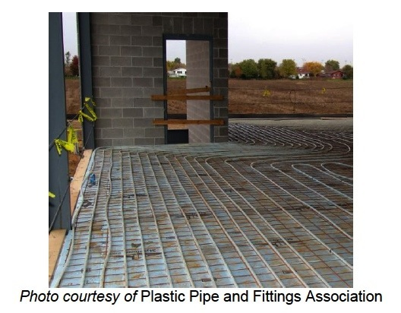
Radiant Heating Systems
© PPFA 2011
Energy Conservation Systems
Notes:
Another liquid based - hydronic system is the radiant heating (or cooling) system. In these systems, small diameter typically PEX or other plastic tubing is run under floors – or in some cases, walls and ceilings. In the picture, this is a large manufacturing building in MN.

Slide 34
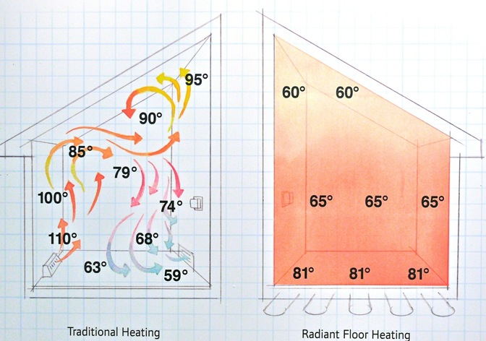
Radiant Heating Systems
Ductless radiant heat causes “reverse stratification”, and is most efficient in large spaces with high ceilings.
© PPFA 2011
Energy Conservation Systems
Notes:
Radiant heat technology heats space by applying heat underneath or within floors of a building. The conditioned space is then heated by radiation. The heat remains closer to the floor in an effect called reverse stratification. A study by ASHRAE indicated that a space heated in this way can keep people comfortable with a 6 to 8 F lower temperature – saving energy. These systems, therefore are more efficient in large spaces with high ceilings.

Slide 35
Radiant Heating Systems
Other advantages:
A ductless water based, “hydronic” system allows for room or even area zoning for precise control by using valves.
Quiet, does not alter room humidity or “dry-out” the air.
© PPFA 2011
Energy Conservation Systems
Notes:
Other advantages include, ductless water based, “hydronic” systems allows for precise room or even area zoning by using valves. With more control comes the potential for more energy savings.
The systems are also quiet, and not fan based, and unlike some combustion systems, do not alter room humidity or “dry-out” the air.

Slide 36
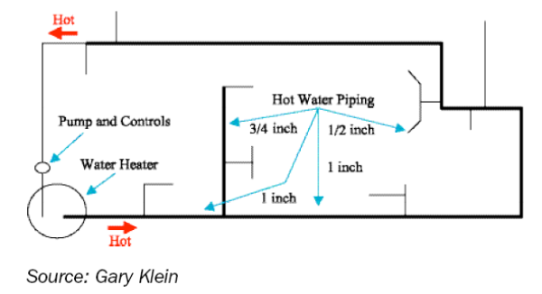
High-Efficiency Hot Water Distribution Systems
© PPFA 2011
Energy/Water Conservation Systems
Notes:
How we delivering hot water to a fixture is about to get more complicated, but with very good reason. First lets discuss how energy intensive hot water is.
And then why high-efficiency hot water systems conserve water AND energy – the reason for the red and blue border in this case.

Slide 37
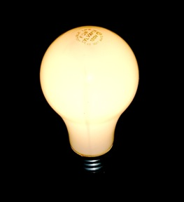
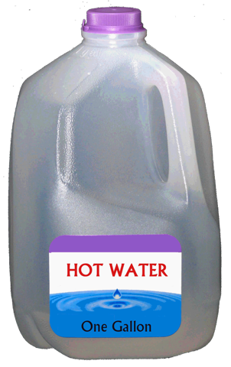
Electricity Used for One Gallon Hot Water ~ 180W watt/hrs
= Or, three 60W light bulbs
running for one hour.
+80F
© PPFA 2011
Notes:
First, let’s talk about electrically heated water - If I wanted to “make” one gallon of hot water, one way would be to heat it with 180 watts of energy for one hour. The same energy to run three old incandescent 60W light bulbs for one hour.
What if I wanted to use a tankless heater system to get the water hot instantly? Say to produce a flow rate of just one gallon of water a minute raised 80 F?
Well, that would be 0.180 kWh / 1/60th hour = 10.8 kW (about 11 kW)
Now one GPM of hot water ( plus one gallon of cold water) is essentially a normal flow through a modern fixture of 2.0 GPM max. How many light bulbs is that?

Slide 38

1 gpm of hot water ~ 11 kW ( or 180 60w light bulbs! )
© PPFA 2011
Notes:
An amazing 180 light bulbs!
So, running a hot water fixture –even a water conserving fixture - normally – just a gallon a minute of hot water - is equal to using the energy used to simultaneously power all 180 of these 60 watt light bulbs.
Surprised? Now you know why there are no monster sized electrical tankless heaters used in homes….. The electrical demand would be too high. Most of them are gas powered.

Slide 39
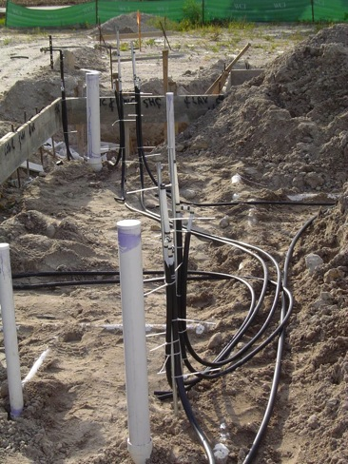
First – what is wrong today with hot water systems?
Longer pipe runs
Heater in garage
Multiple fixtures
Oversized piping
Pipes under slab
Restricted fixtures
© PPFA 2011
Energy/Water Conservation Systems
Notes:
Well, what is wrong on how we “plumb” homes today?
Almost everything - very long runs from the heater, low flow velocity, very little planning, under-slab installation and low (or no) technology.
All of these things add up to what really annoys the consumer – waiting minutes for hot water to arrive at a fixture, while letting what used to be hot water pour down the drain.
Waiting times for hot water in today’s large homes can exceed three minutes – especially where the heater is hidden in the garage, the piping is run poorly – sometimes following the DWV pipes instead of going directly to the fixture, and the most used fixtures are often in the master bath, situated as far as possible from the garage.

Slide 40
High-Efficiency Hot Water Distribution Systems
Did you know? Heating water in a home is about 14-25% of energy use.
So what are the goals of a High-Efficiency Hot Water Distribution System?
To reduce wait time for hot water delivery at the fixture.
To conserve water
To conserve energy
© PPFA 2011
Energy/Water Conservation Systems
Notes:
Did you know? Heating water in a home is about 14-25% of energy use.
So what are the goals of a High-Efficiency Hot Water Distribution System?
To reduce wait time for hot water delivery at the fixture.
To conserve water
To conserve energy

Slide 41
High-Efficiency Hot Water Distribution Systems
Manifold / Parallel Piping
Hybrid / Remote Manifold
Central Core
“On Demand Loop”
(hot water priming system)
NOT a 24-7 recirculation system!!!!
© PPFA 2011
Energy/Water Conservation Systems
Notes:
So how do we save hot water? There are a number of choices, which we will discuss, but the thing NOT to do is use a 24/7 recirculation system.

Slide 42
High-Efficiency Hot Water Distribution Systems
Continuous recirculation systems and even timer based systems will save water, but use substantially more energy.
Do Not Use!
Most of the wasted energy in in heat loss, not pumping energy. In some cases, energy losses can double the energy used.
© PPFA 2011
Energy/Water Conservation Systems
Notes:
Continuous recirculation systems and even timer based systems will save water, but use substantially more energy.
Do Not Use!
Most of the wasted energy in in heat loss, not pumping energy. In some cases, energy losses can double the energy used.

Slide 43
Manifold / Hybrid Remote Manifolds
© PPFA 2011
Energy/Water Conservation Systems
Notes:
One potential system is use of manifold hot water distribution systems.
Here we have two illustrations - a central manifold, or parallel system on the left and a remote – or hybrid system – on the right.
Both can save significant hot water on cold starts, as the central manifold runs smaller tubing directly to the fixture
The remote manifold can be a better choice in rooms with multiple fixtures that are used in clustered (or tight use) patterns.
A manifold is a layout, and not a piping material, but PEX, composite and CPVC tubing are more common materials using these layouts.

Slide 44
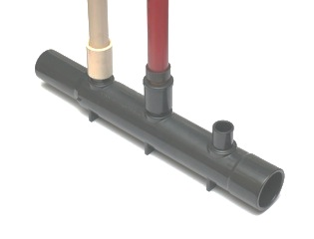
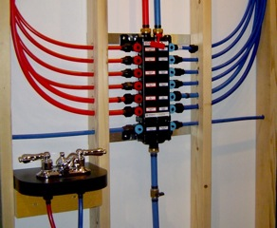
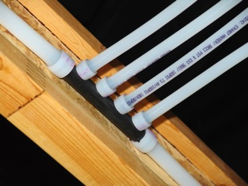
Manifold / Hybrid Remote Manifolds
© PPFA 2011
Energy/Water Conservation Systems
Notes:
Here are images of a typical central manifold and remote manifolds in PEX and CPVC.

Slide 45
Central Core = Centralize Water Heater
Garage
Garage
© PPFA 2011
Energy/Water Conservation Systems
Notes:
Another really easy technique is to centralize the hot water heater. My home has the all too common “electric-water heater in the garage as far away as possible from the master bath” design. Simply moving the heater inside the home would reduce the length of the piping, and the wait and waste.
Use of a tankless heaters can help bring the length of piping down if they can be placed near the point of use.

Slide 46
On Demand = Hot Water Priming
© PPFA 2011
Energy/Water Conservation Systems
Notes:
On demand systems use a a sensor or button to prime a line with hot water – then STOP the pump when a sensor detects the arrival of the hot water. This is far better then a recirculation system, which would save water, but waste energy. The on-demand system is the best of both worlds.

Slide 47
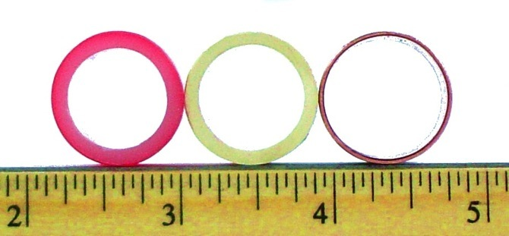
High-Efficiency Hot Water Distribution Systems
Volumes and thermal conductivity vary between all types of tubing. Plastic tubing, like PEX or CPVC reduces wait times with lower internal volume then copper.
Also select tubing certified to NSF-61 if they are intended for any potable water end use.
© PPFA 2011
Energy/Water Conservation Systems
Notes:
Choosing a piping system even makes a difference in efficiency. Volumes and thermal conductivity vary between all types of tubing.
Plastic tubing, like PEX or CPVC reduces wait times with lower internal volume then copper.
Also select tubing certified to NSF-61 if they are intended for any potable water end use. Products intended for potable water will be so certified.

Slide 48
High-Efficiency Hot Water Distribution Systems
Tables have been developed to assist the designers of hot water distribution systems.
Found in the International Plumbing Code:
© PPFA 2011
Energy/Water Conservation Systems
Notes:
You can find a table to help minimize and calculate hot water volume in places like the IPC, IAMPO GPMS, EPA Watersense, IgCC, and in the NGBS.

Slide 49
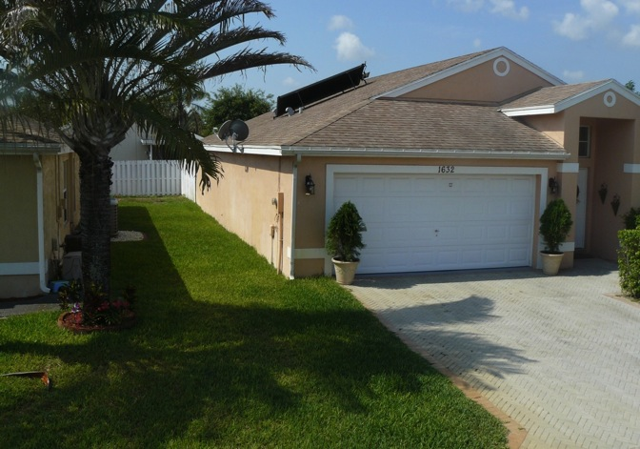
Solar Water Heating Systems
© PPFA 2011
Energy Conservation Systems
Notes:
Why use electricity or gas to heat water from ground temperature to use temperature. – when you can just use the sun?

Slide 50
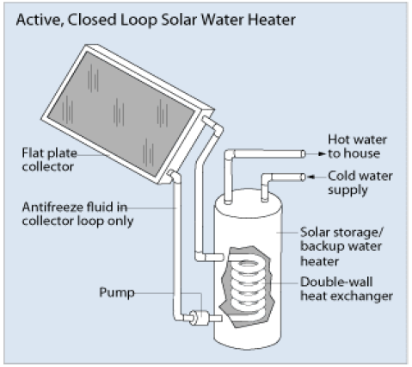
Solar Water Heating Systems
© PPFA 2011
Energy Conservation Systems
Notes:
There are a few kinds of solar water systems, one type is an active collector – which uses a heat exchanger and working fluid separate from the incoming water to heat a tank.
This is also known as an indirect circulation solar heater.

Slide 51
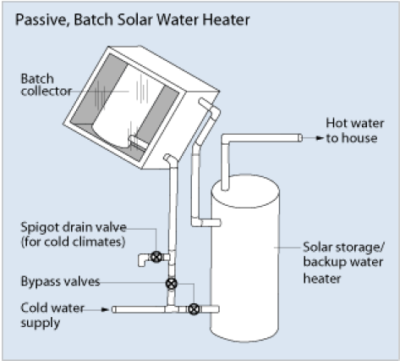
Solar Water Heating Systems
© PPFA 2011
Energy Conservation Systems
Notes:
A passive unit will heat or preheat the water going directly to the water heater – with drain down for winter.

Slide 52
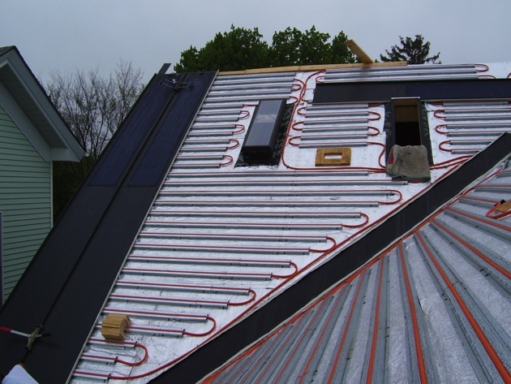
Solar Water Heating Systems
© PPFA 2011
Energy Conservation Systems
Notes:
Here is another passive type – which uses only PEX-AL-PEX type tubing to preheat the water to the heater.

Slide 53
Solar Water Heating Systems
The U.S. Department of Energy (DOE) cites that on average water heating bills drop 50% to 80% when a solar water heating system is installed.
A single family home system ranges between $2,000 and $15,000.
Payback period between 9 and 15 years, although it could be as low as 4 years with government incentives.
© PPFA 2011
Energy Conservation Systems
Notes:
The U.S. Department of Energy (DOE) cites that on average water heating bills drop 50% to 80% when a solar water heating system is installed.
A single family home system ranges between $2,000 and $15,000.
Payback period between 9 and 15 years, although it could be as low as 4 years with government incentives.

Slide 54

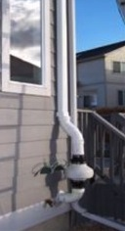
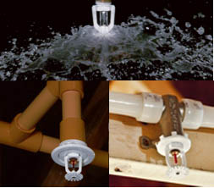
IEQ / Life Safety Systems
There are three technologies covered in the report that reduce or eliminate conditions that could cause health issues or death:
  Radon Venting
  Central Vacuum
  Fire Sprinkler (Residential)
© PPFA 2011
Notes:
In the report, there are three technologies covered in the report that reduce or eliminate conditions that could cause health issues or death:
Radon Venting
Central Vacuum
Fire Sprinkler (Residential)

Slide 55
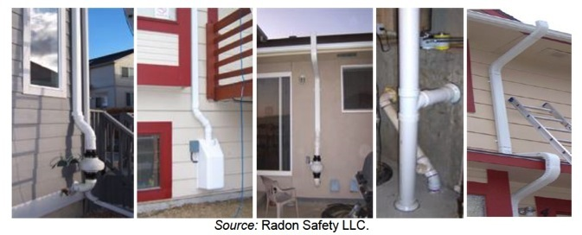
Radon Venting
Radon Venting : an easy and very real lifesaver!
1 in 15 homes
© PPFA 2011
IEQ / Life Safety Systems
Notes:
One very common plastic pipe application is radon venting, and it is a real life saver.

Slide 56
Radon Venting
Nearly 1 out of every 15 homes in the U.S. is estimated to have elevated radon concentrations.
World Health Organization reports that radon is estimated to be responsible for 3-14% of lung cancers worldwide
Most common material is PVC vent piping.
© PPFA 2011
IEQ / Life Safety Systems
Notes:
To me, this is one of those “deep green” systems – unlike products that claim to be green, radon venting systems truly save lives by reducing lung cancer.
That’s hard to beat.
Did you know that nearly 1 out of every 15 homes in the U.S. is estimated to have elevated radon concentrations.
World Health Organization reports that radon is estimated to be responsible for 3-14% of lung cancers worldwide
The most common material is PVC vent piping.

Slide 57
Radon Venting
Radon is responsible for approximately 20,000 lung cancer deaths in the U.S. every year.
Exposure to 4 pCi/L of radon is the equivalent of getting 200 to 300 chest x-rays per year or smoking half a pack of cigarettes per day …
© PPFA 2011
IEQ / Life Safety Systems
Notes:
You should be aware that Radon is responsible for approximately 20,000 lung cancer deaths in the U.S. every year,
And that Exposure to 4 pCi/L of radon is the equivalent of getting 200 to 300 chest x-rays per year or smoking half a pack of cigarettes per day …

Slide 58
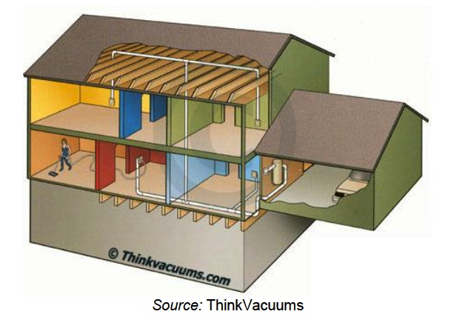
Central Vacuum Systems
© PPFA 2011
IEQ / Life Safety Systems
Notes:
An often over looked system is central vacuum. These systems use plastic piping installed in wall spaces to connect a remote vacuum to lightweight tools used within the various rooms.

Slide 59
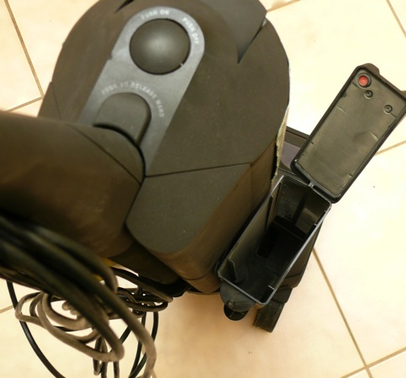
Central Vacuum Systems
© PPFA 2011
IEQ / Life Safety Systems
Notes:
This is my ten year old carpet vacuum. The empty box on the right is where the HEPA air filter is SUPPPOSED TO BE….. If you don’t maintain a self contained vacuum, even the best HEPA vacuum will disperse all manners of particulate into the air.

Slide 60
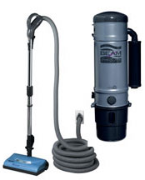
Central Vacuum Systems
Also, the lighter tools are a timesaver:
In one case study in the report, switching to a central vacuum system reduced the cleaning time in a hotel by 38%.
© PPFA 2011
IEQ / Life Safety Systems
Notes:
Central vacuum cleaners have many unique advantages.
The whole central vacuum cleaning system is a closed system, there is an engine suction unit and a collection canister connected by plastic tubes to the basement of the house or outside the walls of the building and these flexible hoses can be fitted to the wall
There is no cumbersome – and potentially dangerous pushing or pulling the heavy tank up and down stairs like the other standup vacuum cleaners.
If fact, I could not imagine a better product to recommend to install in homes that may house elderly or well, really anyone.

Slide 61
Central Vacuum Systems
Advantages:
Can actually improve the indoor environment – even if a bag or filter fails - when properly vented outside.
Quiet (IEQ) – motor is typically in garage/basement
Landfill fewer disposable bags and filters
Safer / lighter to use – less potential slips, trips or falls.
© PPFA 2011
IEQ / Life Safety Systems
Notes:
Central vacuum cleaners have many unique advantages.
The whole central vacuum cleaning system is a closed system, with the unit located in the basement of the house or outside the walls of the building.
The exhaust filter of these central vacuum cleaning systems or machines is installed in the exterior part of the house thus enabling to purify the atmosphere and improve the air quality indoors.
Since the main suction motor is outside the building or installed in the basement or in the garage, the central vacuum cleaner is the quietest vacuum cleaning machine.
Fewer bag dumps and materials to landfills.
There is no cumbersome – and potentially dangerous process of pushing or pulling the heavy container tank up and down stairs like the other standup vacuum cleaners.
If fact, I could not imagine a better product to recommend to install in homes that may house elderly, set for age in place, or well, really anyone.

Slide 62
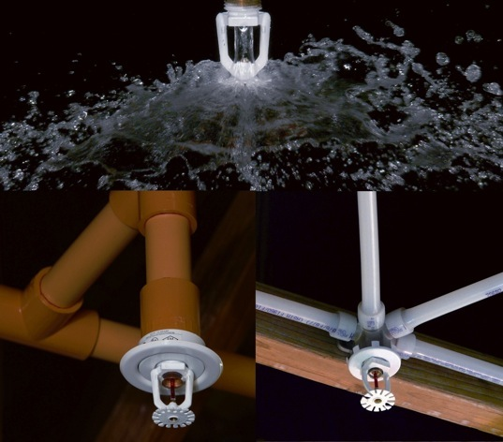
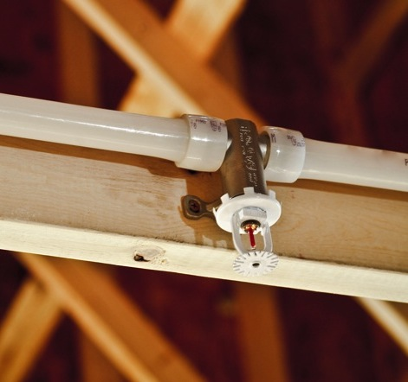
Residential Fire Sprinkler Systems
© PPFA 2011
IEQ / Life Safety Systems
Notes:
Another life safety system is residential fire sprinkler systems. Slowly becoming mandatory in some areas, these systems are not yet mentioned in any green building system.
Let’s face it, the least green and sustainable thing your building can do, is burn down.

Slide 63
Residential Fire Sprinkler Systems
Did you know?
There are over 400,000 residential fires in the US a year.
2,895 civilian fire deaths
7.5 billion in damage
© PPFA 2011
IEQ / Life Safety Systems
Notes:
Did you know, that there are over 400,000 residential fires in the US a year, causing around 2,895 civilian fire deaths and about 7.5 billion in damage?

Slide 64
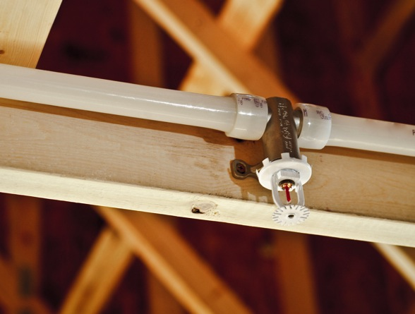
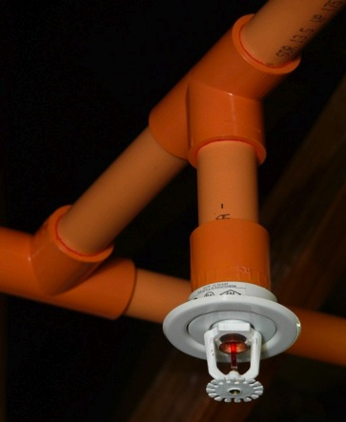
Residential Fire Sprinkler Systems
Residential Sprinkler systems are most commonly:
Stand Alone (own water supply)
Multipurpose (integrated with potable cold water lines)
Network (on a manifold system)
Heads activate individually!
© PPFA 2011
IEQ / Life Safety Systems
Notes:
Residential fire sprinkler systems are commonly set up in stand alone systems (separate from the potable distribution lines in the building) or multipurpose, or integrated with the potable lines in the building.
Network systems, used with manifold piping also exist.
Residential fire sprinkler heads ONLY activate one at a time, based on local heating – they do not go off all at once!

Slide 65
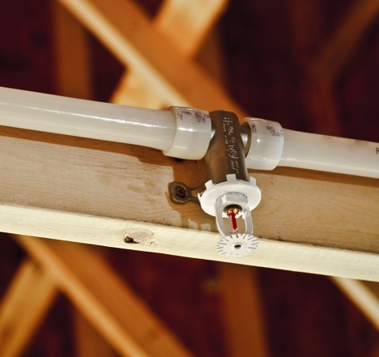
Residential Fire Sprinkler Systems
Advantages:
Reduce home deaths by 80-85%
Especially useful for people who cannot self evacuate: infants, elderly, deaf, or disabled.
Are inconspicuous
Typically use CPVC and PEX tubing approved for fire sprinkler use
Quick response – much faster than a fire department
© PPFA 2011
IEQ / Life Safety Systems

Slide 66
Residential Fire Sprinkler Systems
A FM Global study, The Environmental Impact of Automatic Fire Sprinklers, found that in a fire these systems can:
Reduce fire damage by up to 97%
Reduce greenhouse gasses released by 98%
Reduce water usage to fight a home fire by upwards of 8.5 times
Reduce the amount of water pollution released into the environment
© PPFA 2011
IEQ / Life Safety Systems
Notes:
A FM Global study, The Environmental Impact of Automatic Fire Sprinklers, found that in a fire these systems can:
Reduce fire damage by up to 97%
Reduce greenhouse gasses released by 98%
Reduce water usage to fight a home fire by upwards of 8.5 times
Reduce the amount of water pollution released into the environment

Slide 67
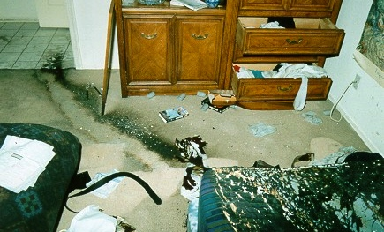
Residential Fire Sprinkler Systems
© PPFA 2011
IEQ / Life Safety Systems
Notes:
Can it save lives?
This is an amazing example of an attempted arson/homicide with a suspect pouring gasoline on a sleeping victim – you can see the accelerant trail to the hall way. The intended victim was saved by the sprinkler, and didn’t even need a hospital stay.
The outcome without the system would have been very different.

Slide 68
THANK YOU!
Green Building Systems – Plumbing and Mechanical
More information can be found on PPFA’s website: www.ppfahome.org.
© PPFA 2011
Notes:
Thanks for, attending this online session on green building systems, and working to set yourselves apart in the building of our energy and water efficient future homes.
More information can be found on PPFA’s website www.ppfahome.org.

